Slide 1
Greek Sources in the Vulgate of Hosea 1–4
Maria Yurovitskaya HSE University

Slide 2
The Vulgate was especially influenced by Symmachus
Cannon, W.W., “Jerome and Symmachus: Some Points in the Vulgate Translation of Koheleth,” ZAW 45 (1927): 191–99.
Salvesen A. Symmachus in the Pentateuch, Manchester 1991, 265–81.
Weigert S. Hebraica veritas: Übersetzungsprinzipien und Quellen der Deuteronomiumübersetzung des Hieronymus. Stuttgart 2016.

Slide 3
Jerome’s use of the LXX and the Hexaplaric revisions was similar to modern critical scholarship
Kedar-Kopfstein B. The Vulgate as a Translation: Some Semantic and Syntactical Aspects of Jerome’s Version of the Hebrew Bible, PhD diss. Hebrew University of Jerusalem, 1968).
Graves M. Jerome’s Hebrew Philology: A Study Based on His Commentary on Jeremiah, Leiden: Brill, 2007.
Kraus M. Jewish, Christian, and Classical Exegetical Traditions in Jerome’s Translation of the Book of Exodus: Translation Technique and the Vulgate, Leiden: Brill, 2017

Slide 4
J. Barr, ‘St Jerome’s Appreciation of Hebrew, Bulletin o f the John Rylands Library 49 (1966-7), pp. 281-302

Slide 5
Vorlage = MT?
B. Kedar-Kopfstein DIVERGENT HEBREW READINGS IN JEROME'S ISAIAH. 1964

Slide 6
Previous comparison of the Vulgate of Hosea with the Three
Ziegler, J., Die jüngeren griechischen Übersetzungen als Vorlagen der Vulgata in den prophetischen Schriften (Braunsberg: Staatt. Akademie zu Braunsberg, 1943).

Slide 7
1 Agreements between Vg and α᾽σ᾽θ᾽ = MT contra LXX
the largest group of agreements
are not decisive with regard to whether Jerome was directly influenced by a certain reading of the revision or reached a similar translation of the Hebrew text independently
the Vulgate and the Hexaplaric revisions correctly reflect the MT
or the MT is ambiguous and the Vulgate agrees in the interpretation with one of the Hexaplaric revisions contra the LXX

Slide 8
1) The LXX either reflects a different Hebrew Vorlage or misreads the Hebrew text, whereas the Vulgate correctly translates the MT.
Verse | Vg | MT | Hexapla | LXX
2:12 (MT 2:14) | in saltu | וְשַׂמְתִּ֣ים לְיַעַר | οι λʼ εις δρυμóν Syh | εἰς ματρύριον (*לְעֵד)

Slide 9
2) The reading of the LXX is free, while the Vulgate agrees with the more literal rendering of one of the Hexaplaric revisions.
Verse | Vg | MT | Hexapla | LXX
4:12 | in ligno suo | עַמִּי֙ בְּעֵצ֣וֹ יִשְׁאָ֔ל ‘my people consults its stick/wood’ | αʼ εν ξυλω αυτου σʼ δια ξυλου ‹αυτου› Syh (index mend. super ἐν ῥάβδοις αὐτοῦ) | ἐν συμβόλοις

Slide 10
3) The Vulgate corresponds to a Hexaplaric reading in terms of syntactic interpretation.
Verse | Vg | MT | Hexapla | LXX
4:11 | fornicatio et vinum et ebrietas aufert cor ‘wine and drunkenness take away the heart’ | זְנ֛וּת וְיַיִן וְתִיר֖וֹשׁ יִקַּֽח־לֵֽב | σʼ και οινος και μεθυσμα αφαιρειται καρδιαν Syh | πορνείαν καὶ οἶνον καὶ μέθυσμα ἐδέξατο καρδία ‘the heart takes wine and drunkenness’

Slide 11
4) The Vulgate follows one of the Hexaplaric revisions in lexical identification.
Verse | Vg | MT | Hexapla | LXX
3:2 | et fodi eam ‘dig’ | וָאֶכְּרֶ֣הָ | αʼκαι εσκαψα αυτην Syh | καὶ ἐμισθωσάμην
in Deut 2:6 the Vulgate translates וְגַם־מַ֜יִם תִּכְר֧וּ as aquam emptam haurietis

Slide 12
4) The Vulgate follows one of the Hexaplaric revisions in lexical identification.
Verse | Vg | MT | Hexapla | LXX
4:5-6 | nocte tacere feci matrem tuam conticuit populus meus | לָ֑יְלָה וְדָמִ֖יתִי אִמֶּֽךָ׃ נִדְמ֥וּ עַמִּ֖י | αʼ νυκτος εσιωπησα σʼ νυκτος σιωπησω θʼ νυκτος εσιωπησα Syh αʼ εσιωπησε λαος μου σʼ εφιμωθη θʼ εσιωπησεν Syh | νυκτὶ ὡμοίωσα τὴν μητέρα σου ὡμοιώθη ὁ λαός μου

Slide 13
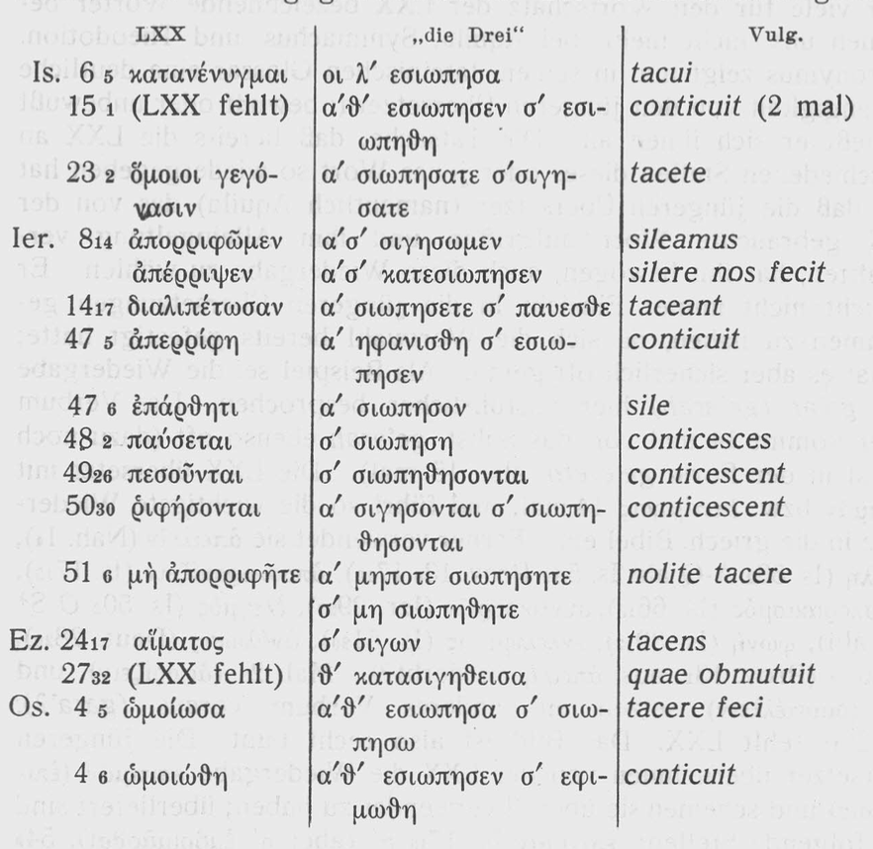

Slide 14
2 Direct borrowings from the Hexaplaric revisions that have no correspondence in the MT
Verse | Vg | MT | Hexapla | LXX
2:15 (17) | vinitores eius | אֶת־כְּרָמֶ֙יהָ֙ | αʼ τους αμπελουργους αυτης σʼ τους αμπελωνας αυτης Syh | τὰ κτήματα αὐτῆς
וְנָתַ֙תִּי לָ֤הּ אֶת־כְּרָמֶ֙יהָ֙ מִשָּׁ֔ם וְאֶת־עֵ֥מֶק עָכ֖וֹר לְפֶ֣תַח תִּקְוָ֑ה וְעָ֤נְתָה שָּׁ֙מָּה֙ כִּימֵ֣י נְעוּרֶ֔יהָ וִּכְי֖וֹם עֲלֹתָ֥הּ מֵאֶֽרֶץ־מִצְרָֽיִם׃
(Hos. 2:17 WTT)
Букв. И дам ей виноградники ее оттуда
а Долину Вреда обращу во Врата Надежды. И даст она там ответ – как в юности, как в день выхода из Египта.

Slide 15
3 The dependence of the vocabulary of the Vulgate on the Greek sources in Hos 1–4
3.1 Jerome’s translation is based on Greek renderings, which were used in the LXX and later adopted by the revisions as standard equivalents
Verse | Vg | MT | Hexapla | LXX
1:4 | visitabo | וּפָ֙קַדְתִּ֜י | αʼ επισκεψομαι Syh | ἐκδικήσω
1:5 | conteram | וְשָֽׁבַרְתִּי | - | συντρίψω
2:21(23) | exaudiam | אֶֽעֱנֶה֙ | - | ἐπακούσομαι
3:1 | amico | רֵ֖עַ | αʼ τω πλησιον σʼ αφ ετερου (leg. εταιρου?) Syh | πονηρὰ

Slide 16
3.1 Jerome’s translation is based on Greek renderings, which were used in the LXX and later adopted by the revisions as standard equivalents
In the Vulgate of Hos 2:21(23)–22(24), ענה ‘to answer’ is rendered as exaudire ‘to listen’, which corresponds to the common way of translating this root in the LXX Psalter and Prophets when God is the subject (εἰσακούειν, ἐπακούειν). This equivalent of ענה was adopted by the revisions of the LXX, which use it similarly to the LXX.
Verse | Vg | MT | Hexapla | LXX
2:21(23) | exaudiam | אֶֽעֱנֶה֙ | - | ἐπακούσομαι

Slide 17
3.2 Jerome’s translation is based on standard equivalents peculiar to Aquila
Verse | Vg | MT | Hexapla | LXX
2:3 (5) | invia | צִיָּה | *α᾽ ἄβατος ‘untrodden’ cf. Isa 41:18, 53:2, Jer 50(27):12 and Psa 77(78):17 | ἄνυδρον
The Vulgate translates צִיָּה as invia throughout the books of Prophets (Isa 41:18, Jer 50:12, Eze 19:13, Joe 2:20, Zep 2:13).

Slide 18
3.2 Jerome’s translation is based on standard equivalents peculiar to Aquila and Symmachus
Jerome used a Hebrew-Greek glossary based on his Greek sources or could recall how different Hebrew words were translated in the LXX and the Hexaplaric revisions?

Slide 19
4.1 Зависимость от Септуагинты (или Vetus Latina?) на уровне лексических соответствий
Verse | Vg | MT | Hexapla | LXX
Hos 4:9 | cogitationes = VL | וּמַעֲלָלָ֖יו | *επιτηδευματα ср. 5:4, 7:2 | τὰ διαβούλια
5:4 διαβούλια] αʼ επιτηδευματα σʼ βουλας θʼ γνωμην 86
Слово מַעֲלָלִים «дела». В Септуагинте и ревизиях обычно переводится как επιτηδευματα ‘занятия’. Исключение составляют три места в книге Осии, где это еврейское слово передается как τὰ διαβούλια (Ос 4:9, 5:4, 7:2). Вульгата следует в выборе эквивалентов за Vetus Latinа, в Ос 4:9 и 5:4 cogitationes; в других местах Осии adinventiones.

Slide 20
4.2 Зависимость от Септуагинты (или Vetus Latina?) на уровне интерпретации
Verse | Vg | MT | Hexapla | LXX
Hos 4:2 | maledictum et mendacium et homicidium et furtum et adulterium inundaverunt | אָלֹ֣ה וְכַחֵ֔שׁ וְרָצֹ֥חַ וְגָנֹ֖ב וְנָאֹ֑ף פָּרָ֕צוּ | αʹ ‹αρα και› αρνησις σʼ ομνυων και αρνουμενος θʼ ορκοι και ψευδος Syh | ἀρὰ καὶ ψεῦδος καὶ φόνος καὶ κλοπὴ καὶ μοιχεία κέχυται ἐπὶ τῆς γῆς VL diffusum est super terram
Таргум Ионатана מוֹלְדִין בְנִין מִנְשֵׁי חַברֵיהוֹן, Пешитта ܣܓܝܘ

Slide 21
4.3 Зависимость от Септуагинты (или Vetus Latina): общий Vorlage?
V. | Vg | MT | Hexapla | LXX
2:16 (MT 2:18) | vocabit me Vir meus et non vocabit me ultra Baali = 2 mss Kennikott = Peshitta | תִּקְרְאִ֖י אִישִׁ֑י וְלֹֽא־תִקְרְאִי־לִ֥י ע֖וֹד בַּעְלִֽי | αʹ vocabit me vir meus et non vocabit me (αʹσʹ θʹ και ου καλεσεις με Syh) ultra habens me Hi. | κύριος καλέσει με ὁ ἀνήρ μου καὶ οὐ καλέσει με ἔτι Βααλιμ
3:4 | et sine sacrificio et sine altari et sine ephod et sine therafin = Kennikott 4 and 3 | וְאֵ֣ין מַצֵּבָ֑ה וְאֵ֥ין אֵפ֖וֹד וּתְרָפִֽים | δήλων] σʼ θʼ sine ephod et sine theraphim Hi. ep.29, 6 (CSEL 54, 241 Hilberg); σʼ θʼ ουδε εφωδ ουδε θεραφιμ Syh (mend. σʼ ουδε θερ. θʼ ουδε εφωδ cod.); αʼ και μορφωματων σʼ ουδε επιλυσεως θʼ ουδε επιλυομενου 86 | οὐδὲ οὔσης θυσίας οὐδὲ ὄντος θυσιαστηρίου οὐδὲ ἱερατείας οὐδὲ δήλων

Slide 22
Независимость Иеронима?
В большинстве случаев чтения Вульгаты так или иначе восходят к греческим источникам.

Slide 23
Раввинистическая экзегеза?
Verse | Vg | MT | Hexapla | LXX
2:15 (MT 2:17) | et canet ibi | וְעָ֤נְתָה שָּׁ֙מָּה | αʼ και υπακουσει (αʼ υπακουσει Hi.; σʼ κακωθησεται 86 Hi.lat; θʼ αποκριθησεται Hi.) | καὶ ταπεινωθήσεται ἐκεῖ
= ibn Ezra
וענתה - תנגן ותשיר, כמו: ותען להם מרים. ויש אומרים: ותדור שמה מגזר מעון ויפרש, ככתוב: וענה איים באלמנותיו והוא רחוק בעיני.
Exo 32:18 ק֣וֹל עַנּ֔וֹת
οὐκ—fin] αʹ non est vox eorum qui praecinunt in virtute (bḥyl’ pro bnḥl’) neque est vox eorum qui praecinunt e victoria, sed vocem praecentorum ego audio SyhL; σʹ non est clamor eorum qui mandant (mandantium pro eorum qui m. t) fortitudinem neque clamor mandantium victoriam, sed vocem malitiae ego audio Syh; θʹ non est vox belli praecinentium in virtue (bḥyl’ pro bnḥl’) neque est vox praecentricum victoriae; vocem eorum qui praecinunt ego sum audienes SyhL

Slide 24
Раввинистическая экзегеза?
Verse | Vg | MT | Hexapla | LXX
4:18 | dilexerunt adferre ignominiam protectores eius | אָהֲב֥וּ הֵב֛וּ קָל֖וֹן מָגִנֶּֽיהָ | 18 ἠγάπησαν—fin.] σʼ ηγαπησαν αγαπην οὗ η βοηθεια ατιμια (θʼ σκοπια Syh; leg. σκεπη) Syh | ἠγάπησαν ἀτιμίαν ἐκ φρυάγματος αὐτῶν
Macintosh: For Jerome and the rabbinic commentators (ibn Janāḥ, Rashi, ibn Ezra and Kimchi) the word denotes the kings and princes of the people. The sense of the phrase is then ‘her rulers are shame, ignominy’.
Targum of Jonathan
רְחִימֻו דְיֵיתֵי לְהוֹן קְלָנָא רַברְבֵיהוֹן
В Псалтири: MT מָגֵ֣ן= LXX ὑπερασπιστής = Галликанская Псалтирь protector
Быт 15:1 MT מָגֵ֣ן= Vg protector

